Slide 1
Adding Inventory to a BIBFRAME Instance in Alma
Yoel Kortick
Yoel.Kortick@clarivate.com

Slide 2
Agenda
  Introduction
  Adding Electronic Inventory to an Instance
  Adding Physical Inventory to an Instance
  The Inventory appears in Discovery

Slide 3
Introduction

Slide 4
Introduction
For BIBFRAME records the inventory is added to the Instance (and not to the Work).
The MARC Metadata Editor is used to add inventory to the Instance
  This is the case even though the MARC Metadata Editor is not used to edit the Instance.
    It is only used to add inventory to the Instance.
When we state “Inventory” we mean:
  Holdings Records and Physical Items
  Electronic Collections and Portfolios
  Digital Representations and Files

Slide 5
Introduction
Rather than engage in a long and lengthy explanation of how this is done, we will “jump right in” and show it live.
First, we will add an electronic portfolio to the Instance of an electronic book
Next, we will add a holdings record and physical item to the Instance of a physical book
Note that once we are in the Metadata Editor the flow is the same as it is when adding inventory for any other type of record.

Slide 6
Adding Electronic Inventory to an Instance

Slide 7
Adding Electronic Inventory to an Instance
We will now add a standalone portfolio to the Instance of title “CrossFit training Level 1 training guide Greg Glassman” which has resource type “Book – Electronic”
First, we will push the record to the Metadata Editor
Next, we will select the record from the LC BF INSTANCE tab of the navigation pane of the Metadata Editor.
Then, in the Metadata Editor, we will add the electronic inventory in the same manner as we would do so for any other type of record.
  To add a portfolio, select “Add Inventory > Add Portfolio”

Slide 8
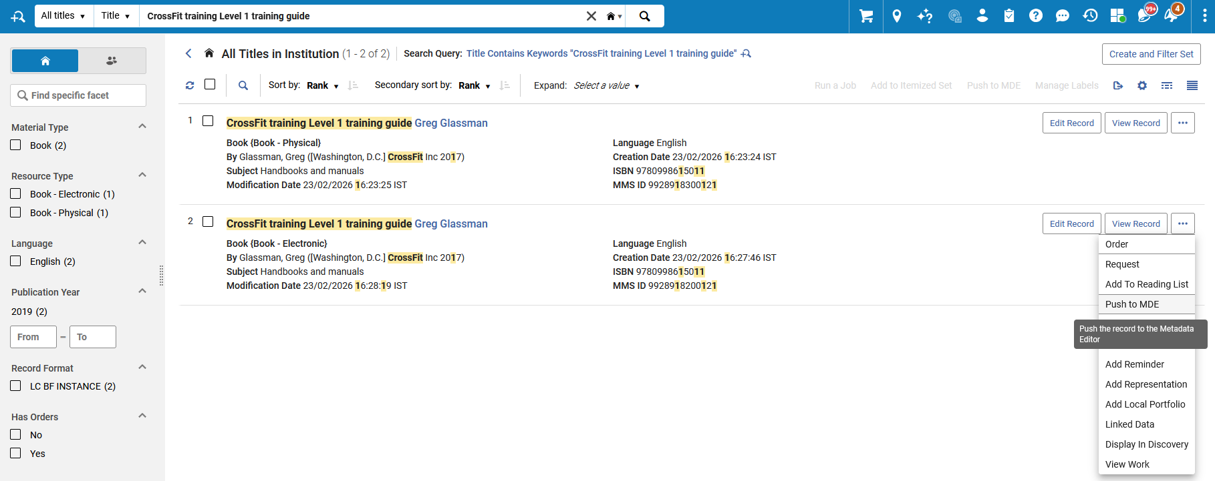
Adding Electronic Inventory to an Instance
Step One
Instance of title “CrossFit training Level 1 training guide Greg Glassman” which has resource type “Book – Electronic”
Push to MDE
Note that there is also an option “Add Local Portfolio” which could also be used depending on the specific situation

Slide 9
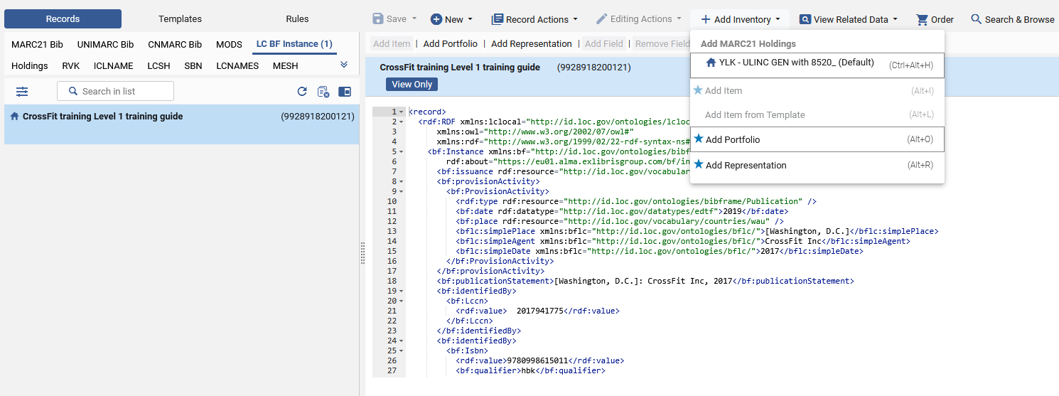
Adding Electronic Inventory to an Instance
Step Two
To add a portfolio, select “Add Inventory > Add Portfolio”
Select the record from the LC BF INSTANCE tab of the navigation pane

Slide 10
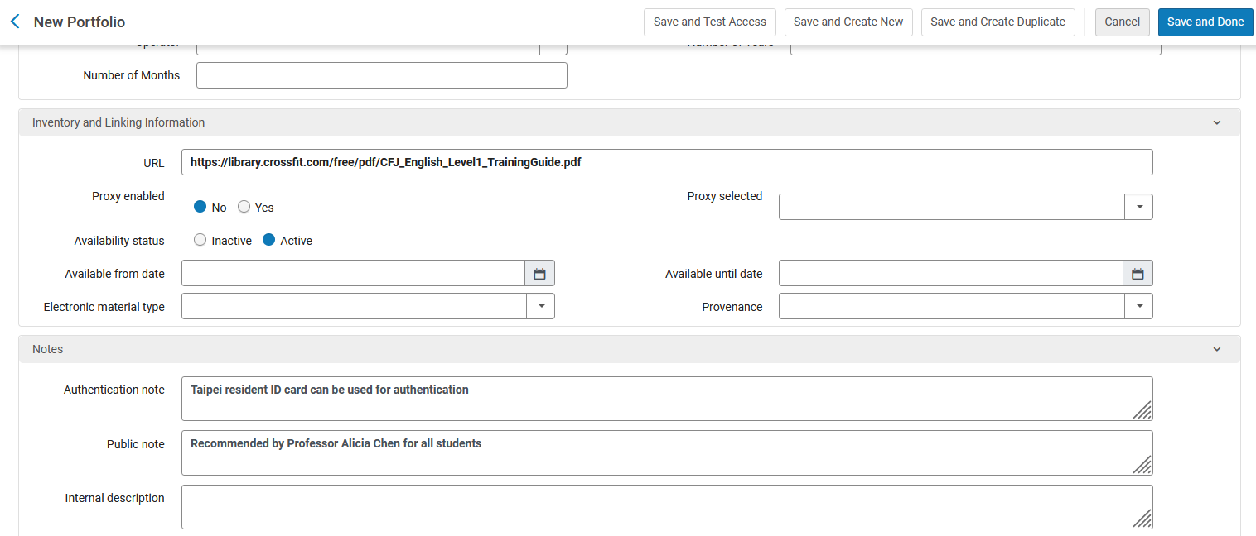
Adding Electronic Inventory to an Instance
Step Three
Add the inventory as you would for any other type of record

Slide 11
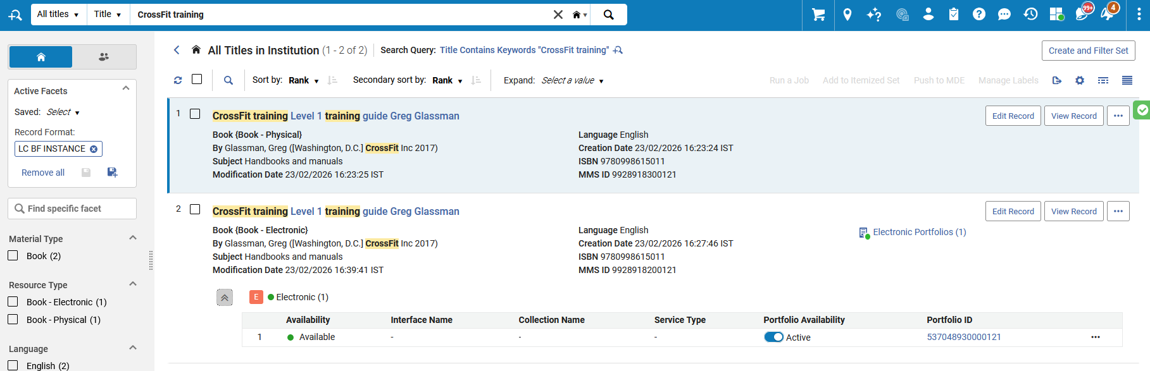
Adding Electronic Inventory to an Instance
Step Four
See that the BIBFRAME Instance now has electronic inventory

Slide 12
Adding Physical Inventory to an Instance

Slide 13
Adding Physical Inventory to an Instance
We will now add a Holdings record and physical item to the Instance of title “CrossFit training Level 1 training guide Greg Glassman” which has resource type “Book – Physical”
First, we will push the record to the Metadata Editor
Next, we will select the record from the LC BF INSTANCE tab of the navigation pane of the Metadata Editor.
Then, in the Metadata Editor, we will add the Physical inventory in the same manner as we would do so for any other type of record.
  To add a Holdings record and physical item:
    first select “Add Inventory > Add MARC21 Holdings”
    then select “Add Inventory > Add Item”

Slide 14
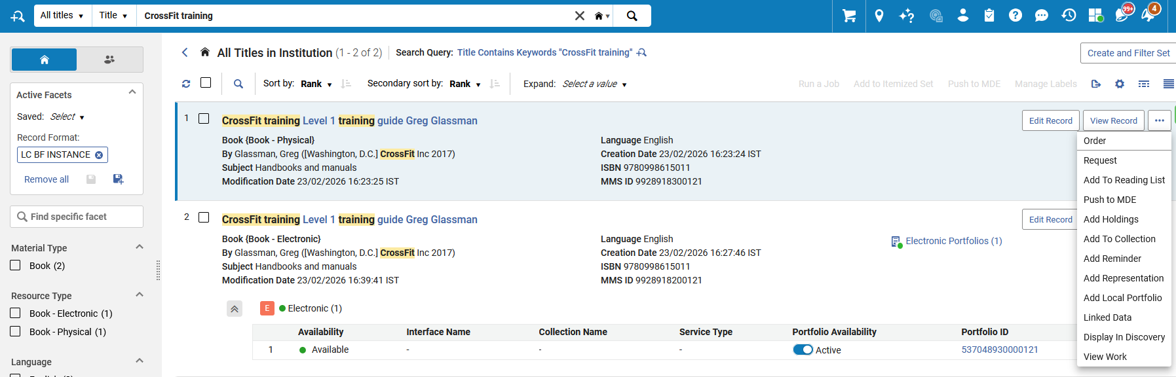
Adding Physical Inventory to an Instance
Step One
Instance of title “CrossFit training Level 1 training guide Greg Glassman” which has resource type “Book – Physical”
Push to MDE
Note that there is also an option “Add Holdings” which would bring the Instance to the Metadata Editor and create an initial Holdings record based on the default template of the Holdings Record

Slide 15
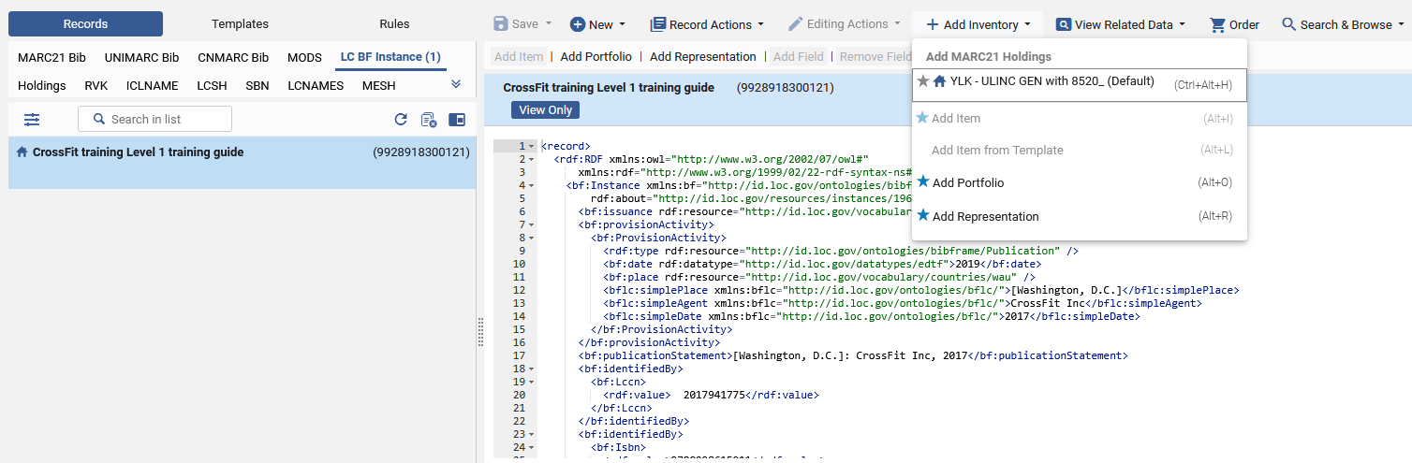
Adding Physical Inventory to an Instance
Step Two
To add a holdings record and physical item: first select “Add Inventory > Add MARC21 Holdings” then select “Add Inventory > Add Item” (What appears here will depend on the Holdings record template setup)
Select the record from the LC BF INSTANCE tab of the navigation pane

Slide 16
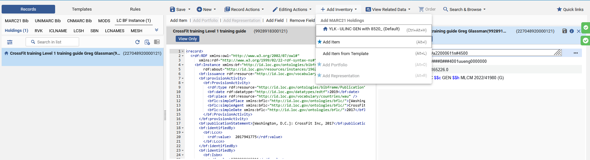
Adding Physical Inventory to an Instance
Step Three
Select “Add Inventory > Add Item”
The holdings record has been created

Slide 17
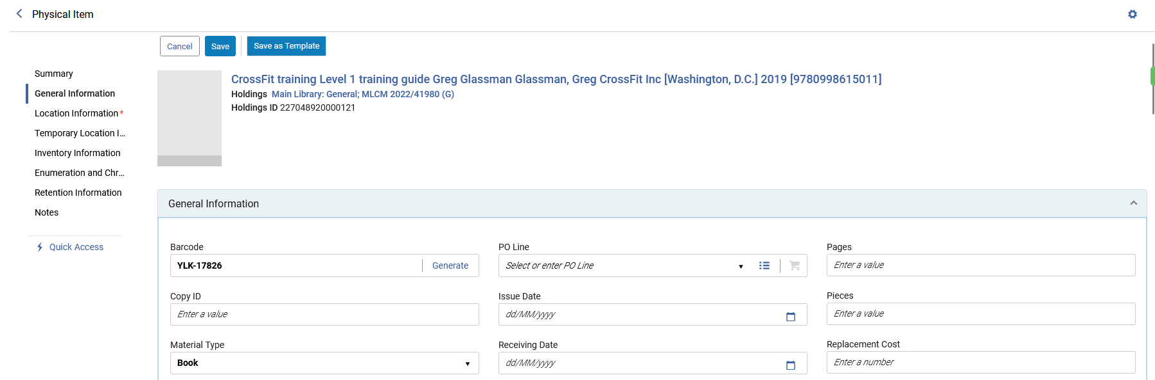
Adding Physical Inventory to an Instance
Step Four
Add the inventory as you would for any other type of record

Slide 18
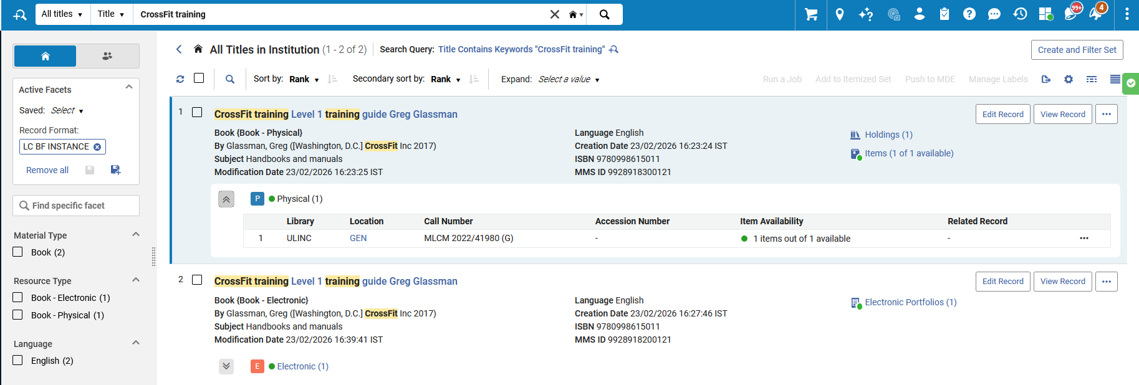
Adding Physical Inventory to an Instance
Step Five
See that the BIBFRAME Instance now has Physical inventory

Slide 19
The Inventory appears in Discovery

Slide 20
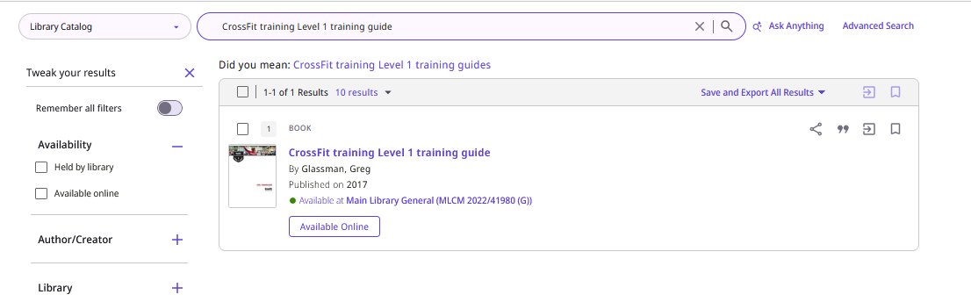
The Inventory appears in Discovery
We retrieve the record in Discovery.
In the brief results the record includes the links to the inventory

Slide 21
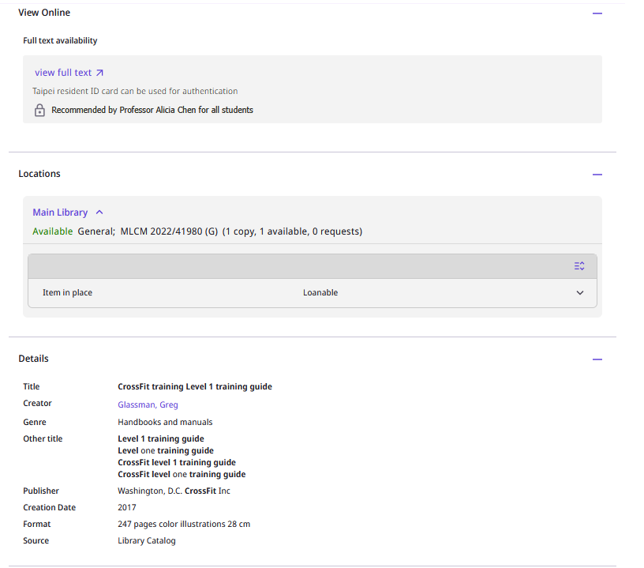
The Inventory appears in Discovery
In the full display the record includes the links to the inventory

Slide 22


Yoel Kortick
Yoel.Kortick@clarivate.com
About Clarivate
Clarivate is a leading global provider of transformative intelligence. We offer enriched data,
insights & analytics, workflow solutions and expert services in the areas of Academia & Government, Intellectual Property and Life Sciences & Healthcare. For more information, please visit clarivate.com.
© 2026 Clarivate. All rights reserved
Clarivate and its logo, as well as all other trademarks used herein are trademarks of their respective owners and used under license.

